Slide 1
Bank Dashborad
File created on: 15/06/21 1:16:17 AM GMT+05:30

Slide 2
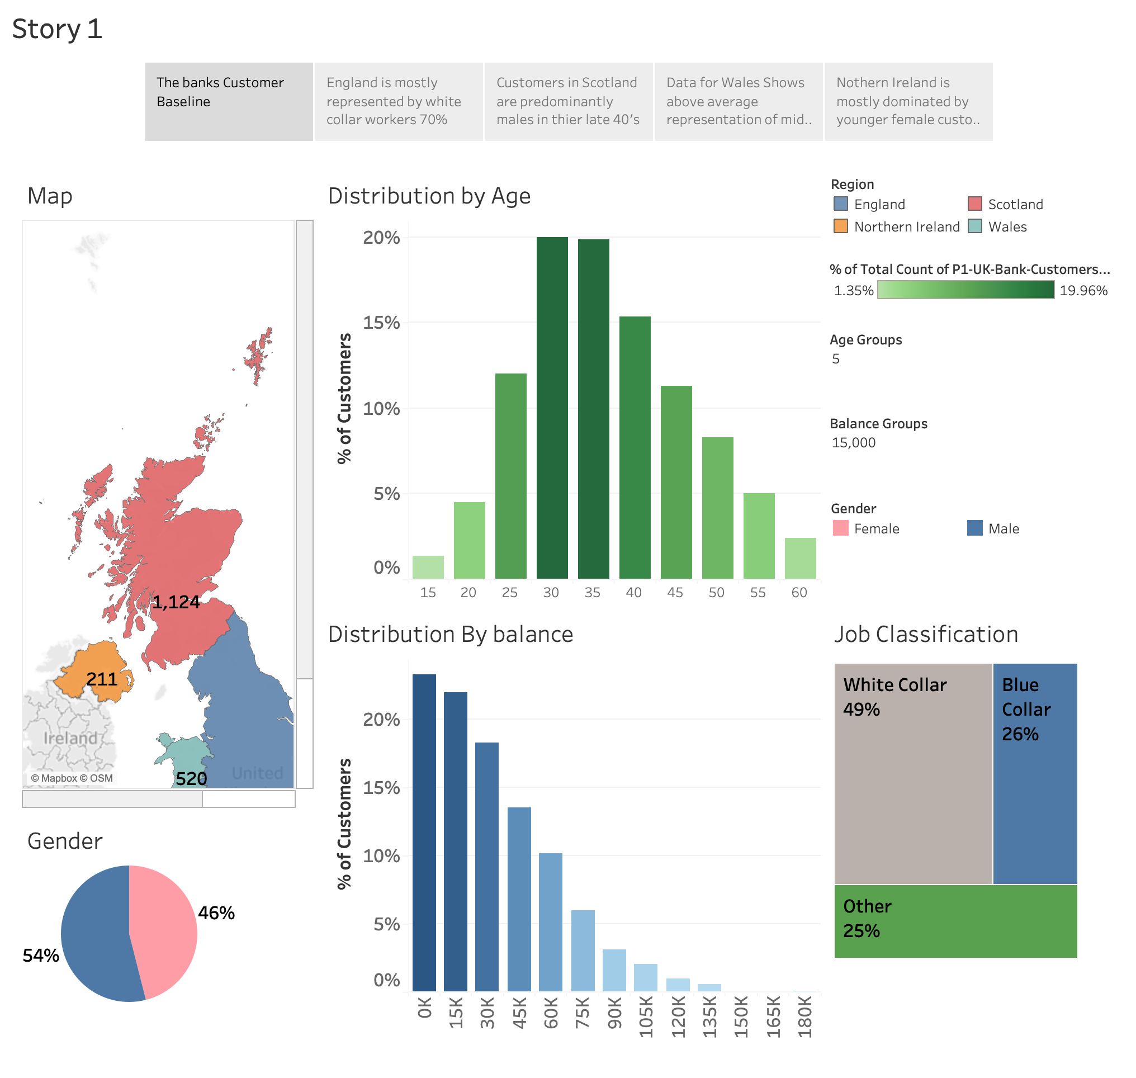

Slide 3
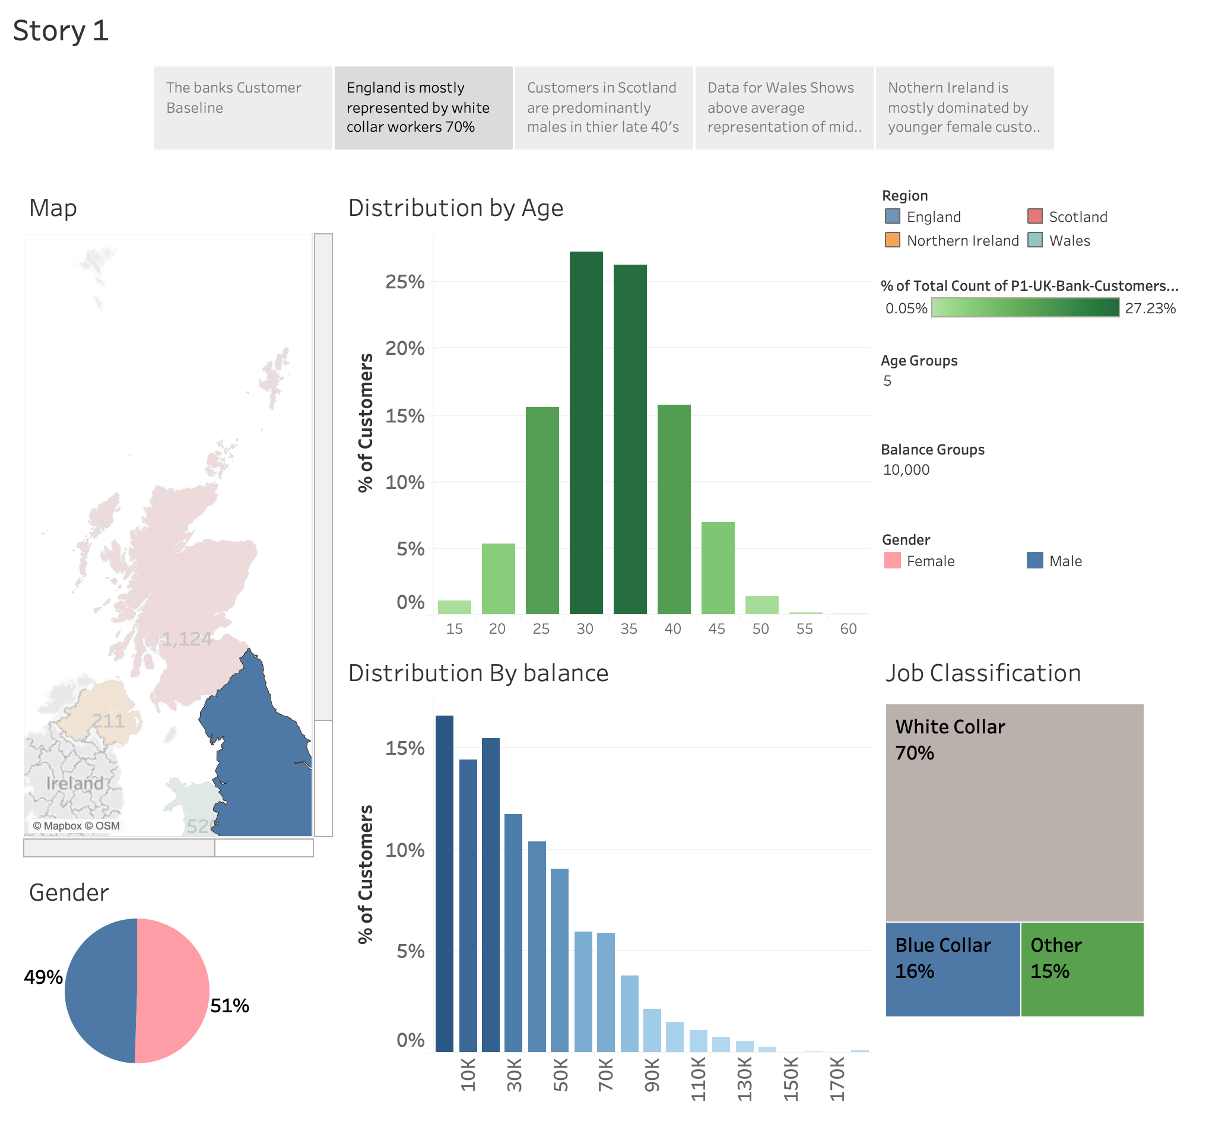

Slide 4
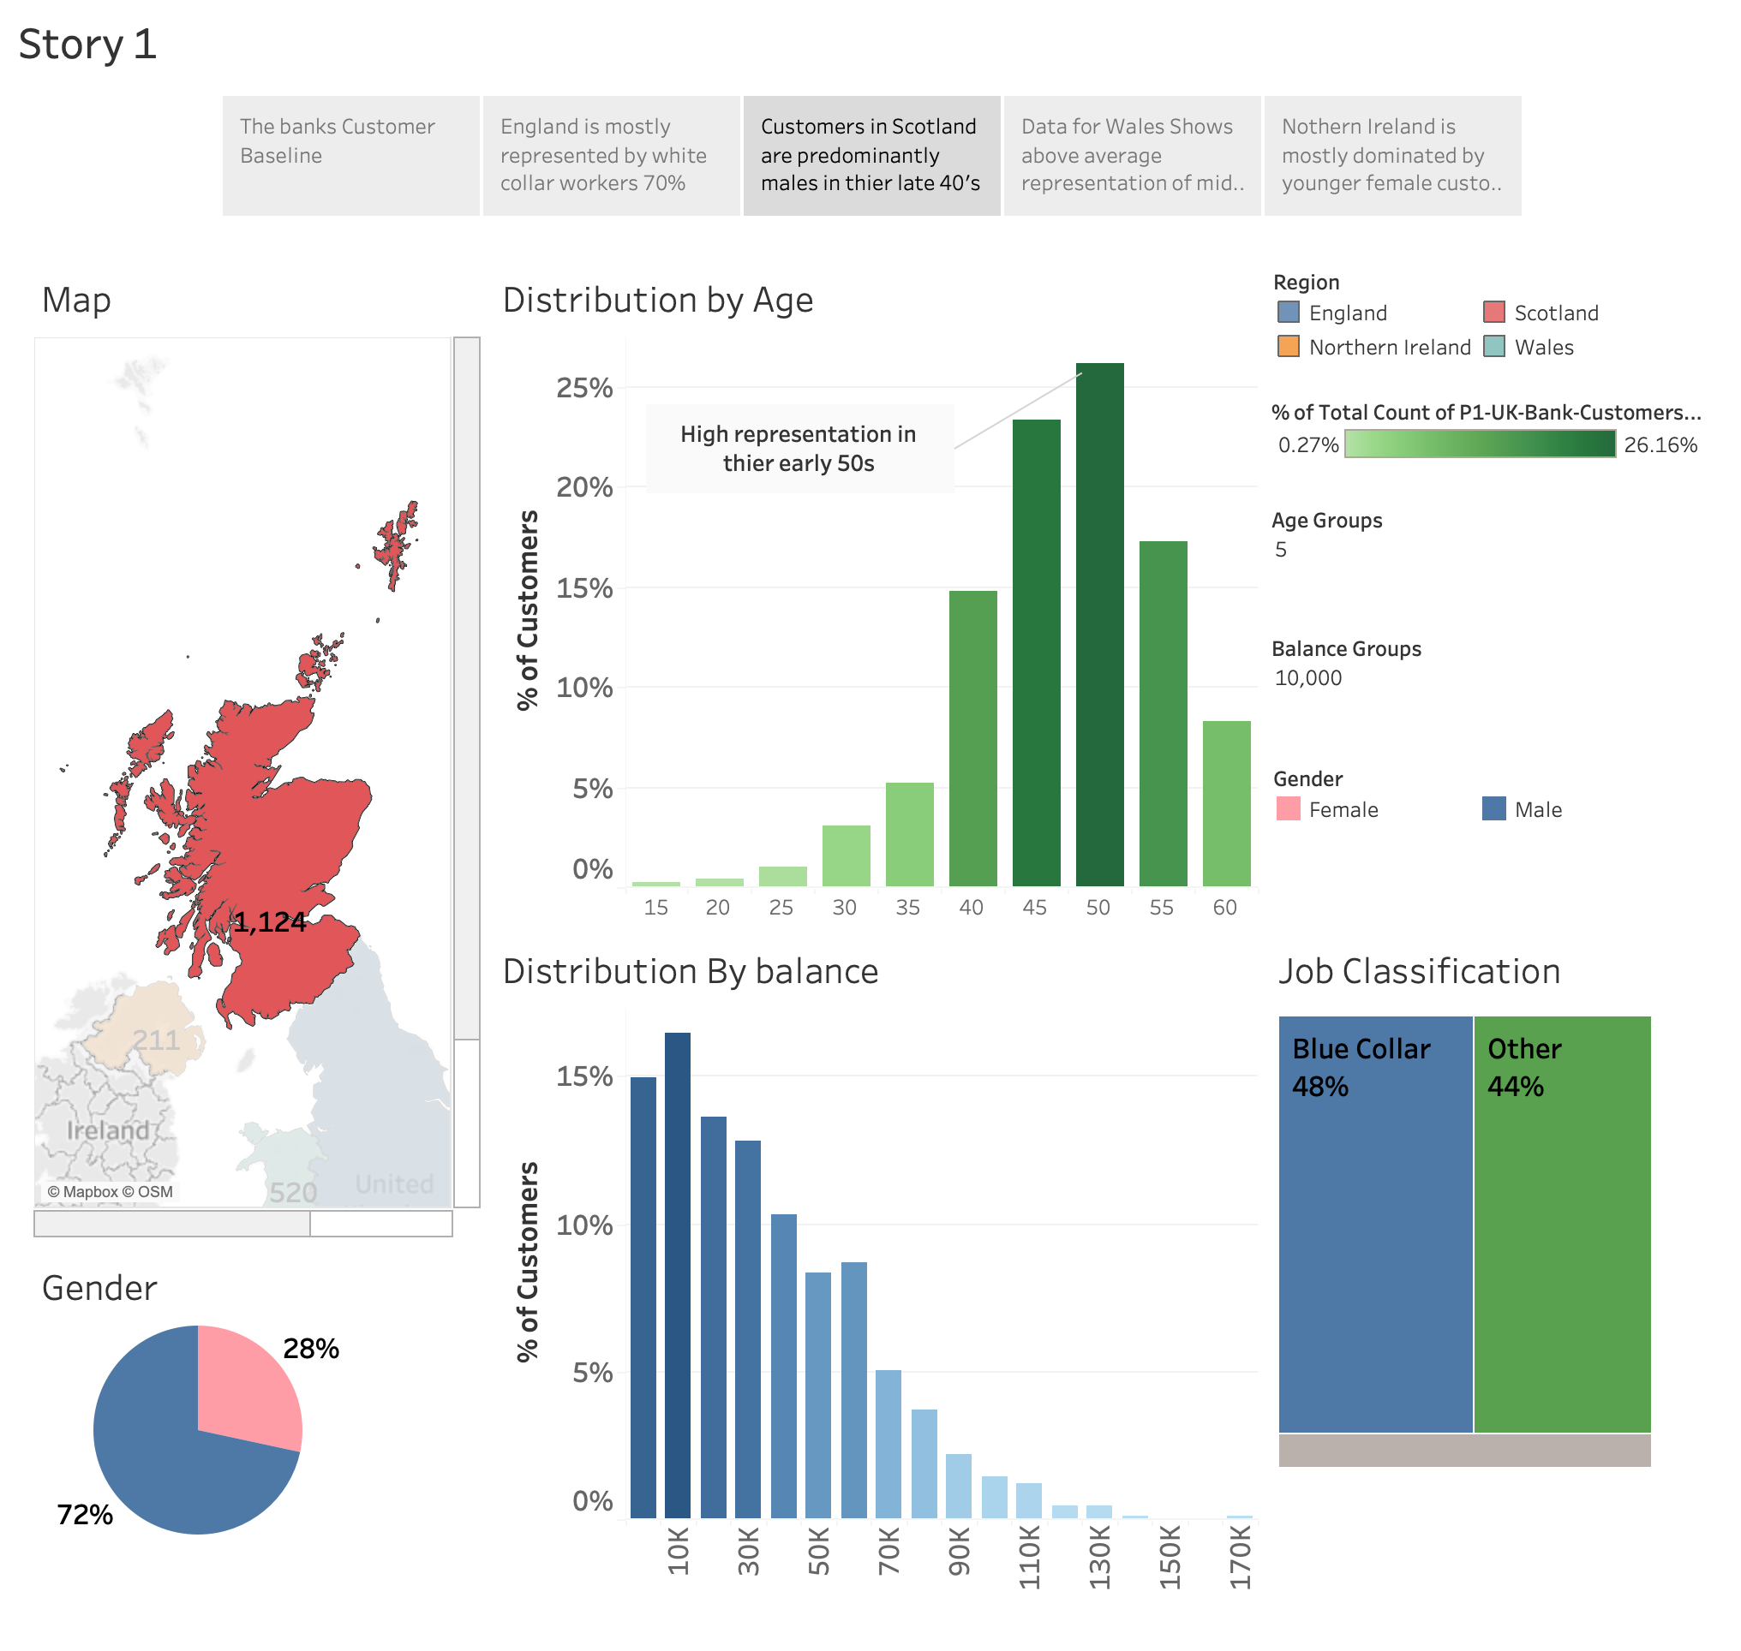

Slide 5
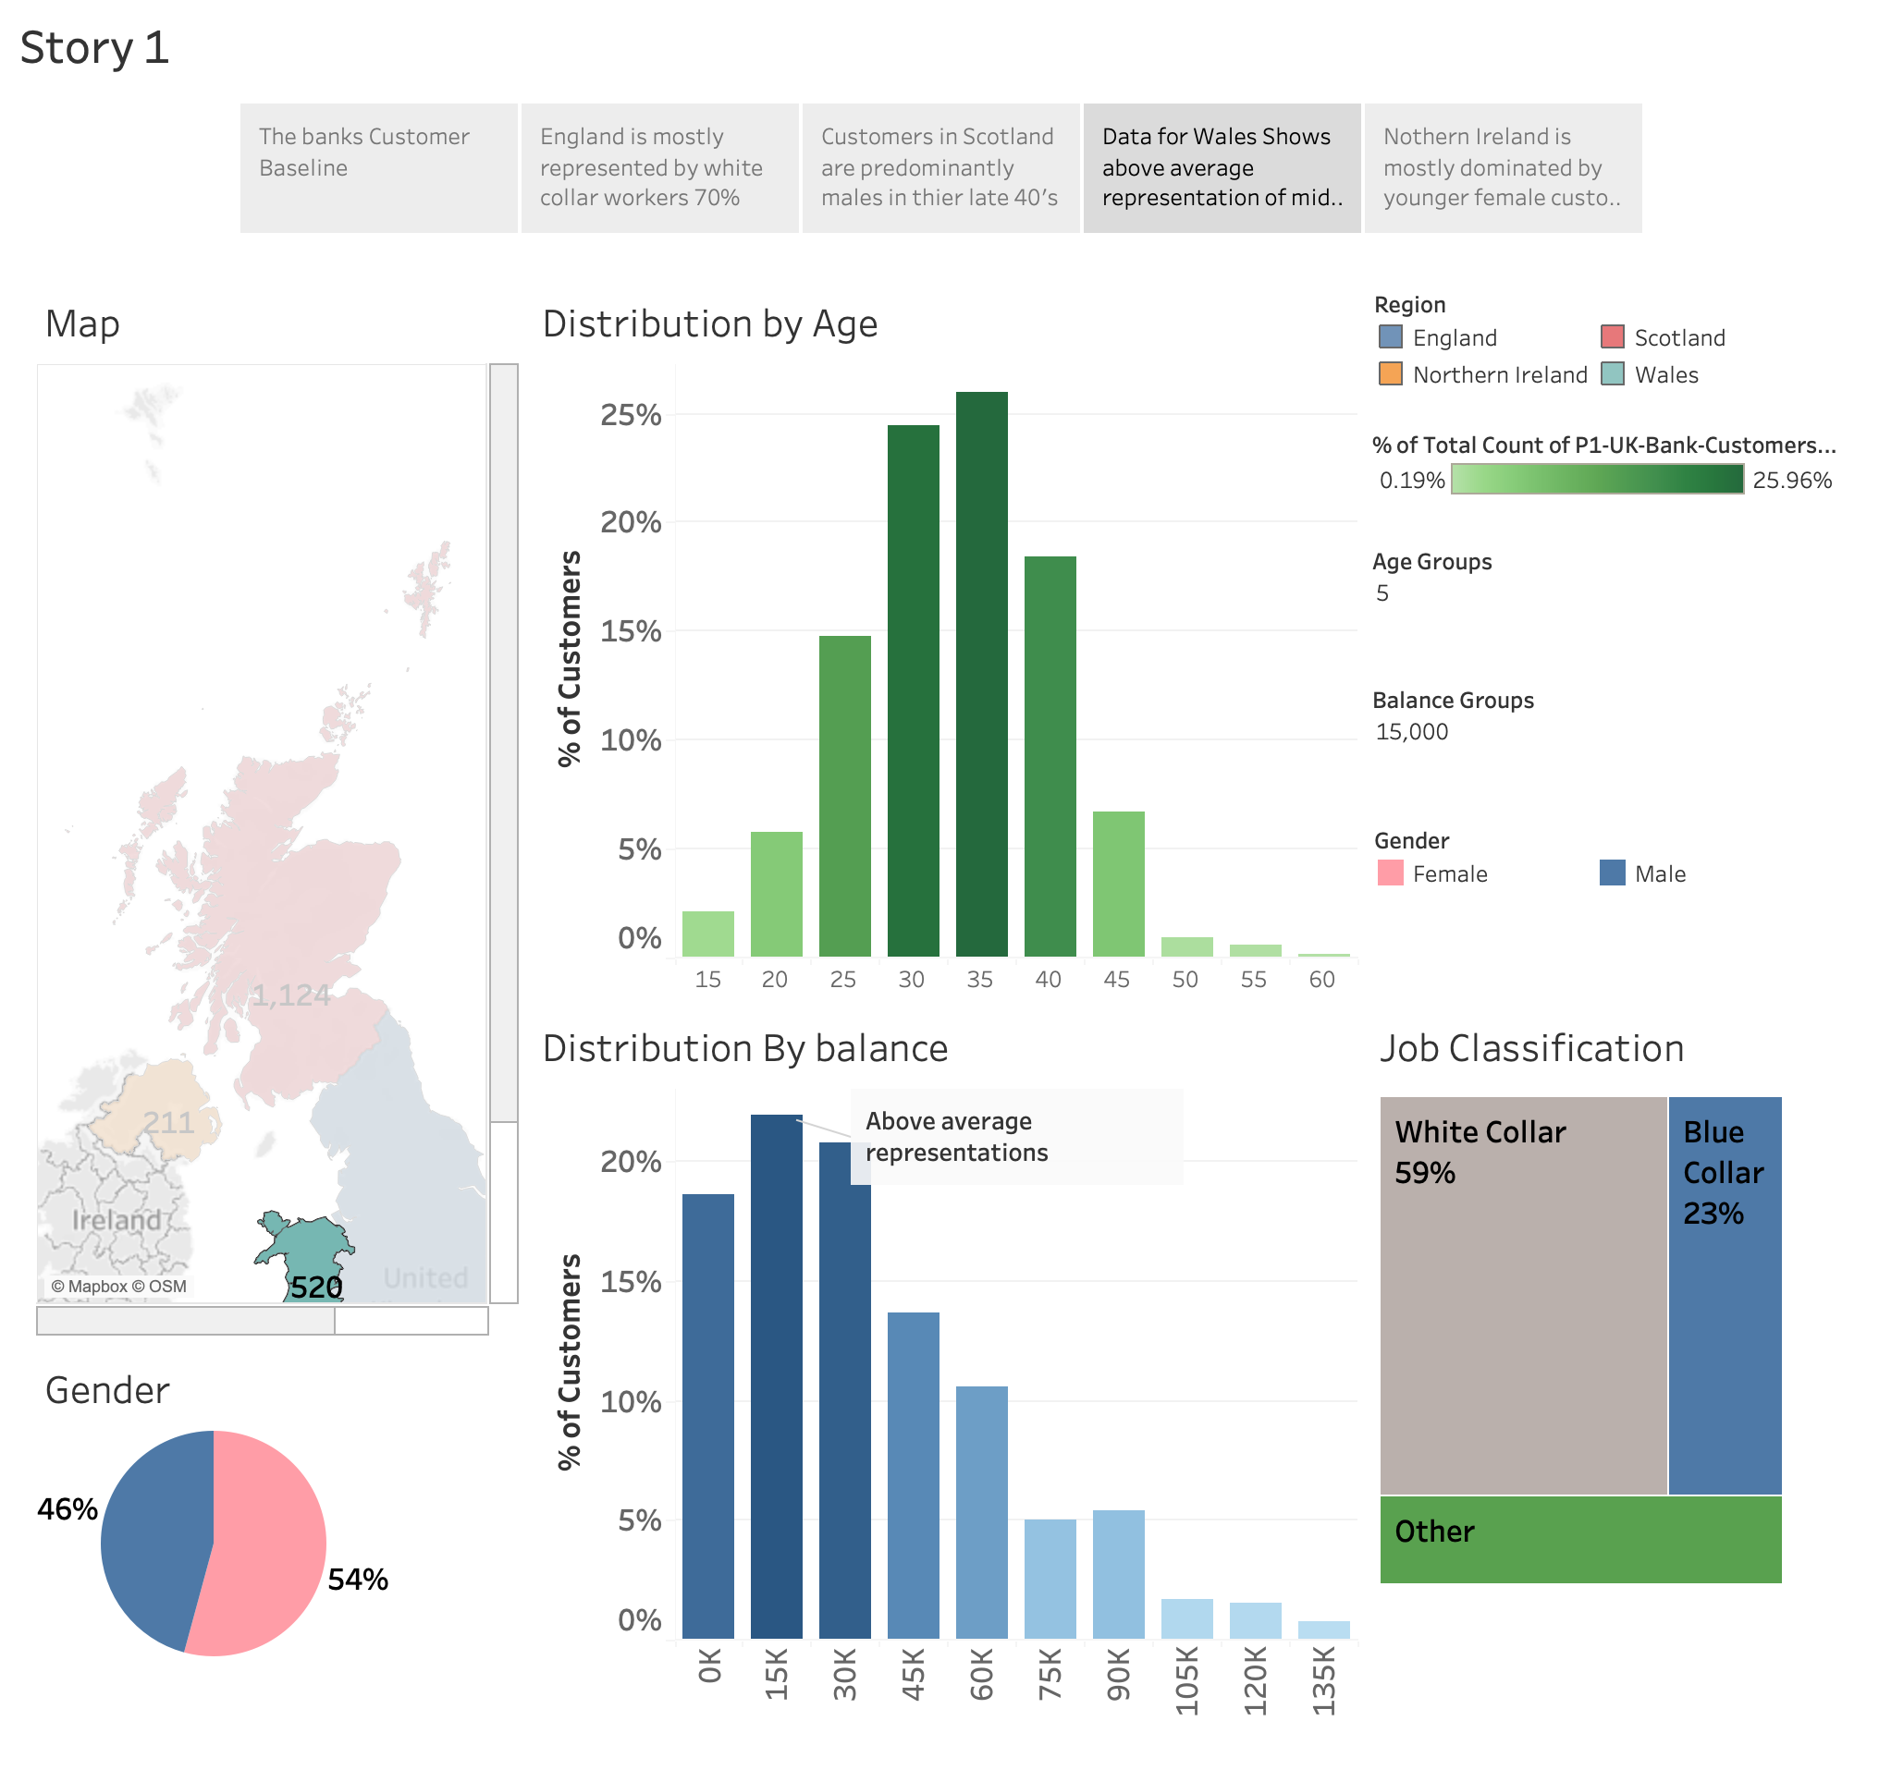

Slide 6
